Slide 1

The Relationship Between SAT Scores and College Acceptance Rates
Jack Olson

Slide 2

Overview
How SAT results vary among California counties
Why SAT scores are an important factor in college admissions
School-based SAT prep courses as a possible solution for counties with below-average SAT results

Slide 3
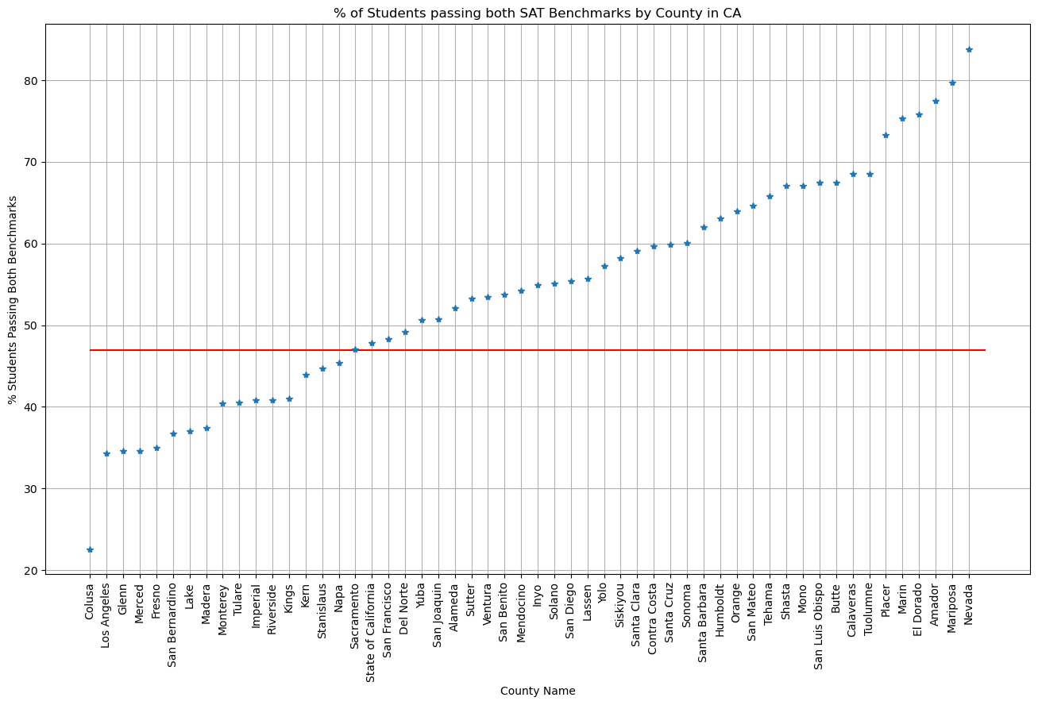
The Percentage of Students Passing Both SAT Benchmarks Varies Widely in California
College Board’s SAT benchmarks are a measure of college readiness
23% of students in Calusa County pass both SAT benchmarks, compared to 84% in Nevada County
The mean school in California has a passing rate of 47%

Slide 4

Assumptions: College Admissions and SAT scores
Acceptance rate is an approximation for college quality
All colleges consider SAT scores in their admission decision, even if submitting SAT scores is optional

Slide 5
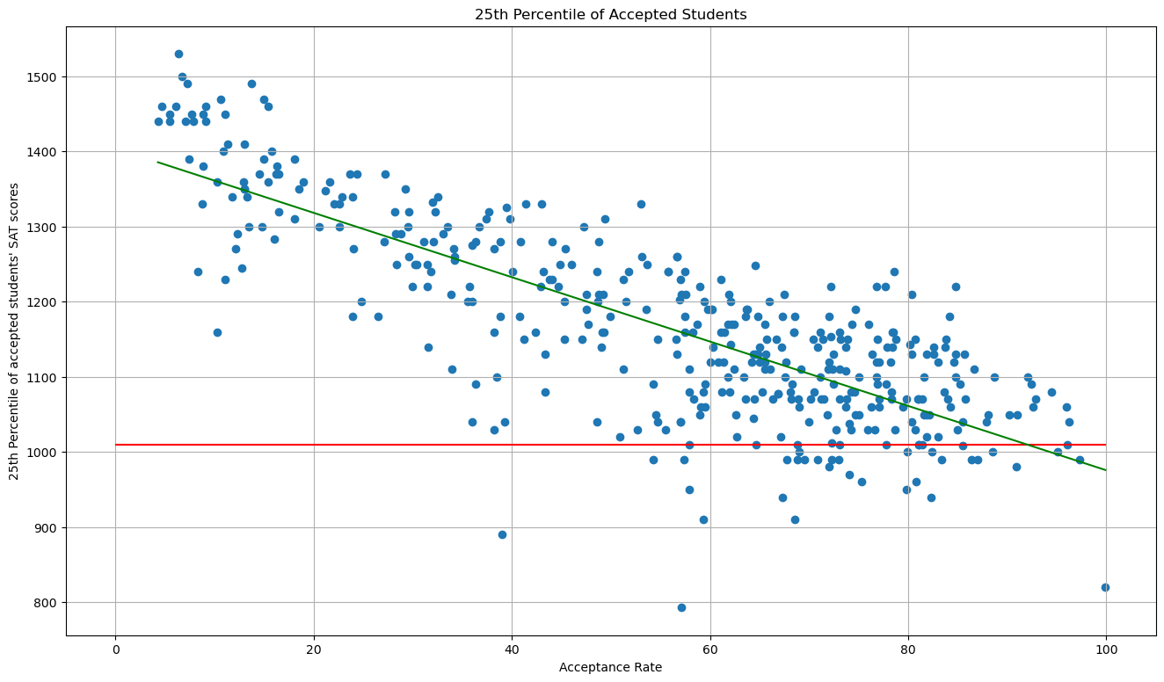
25th Percentile of Accepted Students’ SAT Scores by Acceptance Rate
90% of colleges have a 25th percentile over 1010 points, the sum of College Board’s benchmarks for Math and Writing
The slope of the green regression line shows an inverse relationship between acceptance rate and 25th percentile SAT score

Slide 6
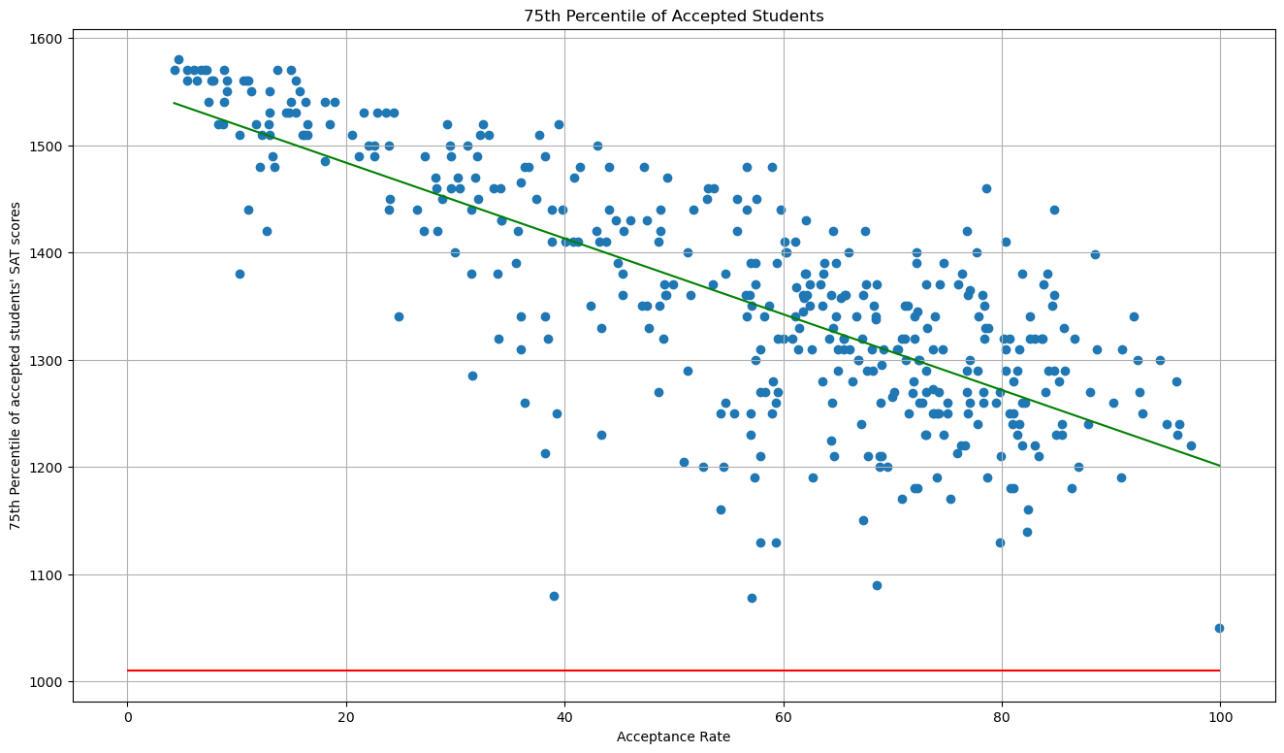
75th Percentile of Accepted Students’ SAT Scores by Acceptance Rate
Zero colleges have a 75th percentile below the benchmark score of 1010 points
Colleges with acceptance rates below 20% have 75th percentiles more tightly clustered at high scores

Slide 7
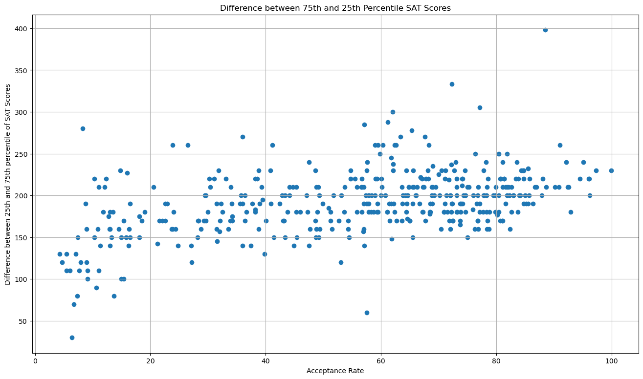
Range between 25th and 75th Percentile of Accepted Students’ SAT Scores by Acceptance Rate
The range between the 25th and 75th percentiles has a very weak relationship to acceptance rate
Colleges with low acceptance rates do not only accept students with high SAT scores

Slide 8

School-based SAT prep courses as a possible solution for counties with below-average SAT results
Intervention Group: 62 students who took a semester-long SAT prep course
Non-intervention Group: 217 students who did not take the course
Null Hypothesis: There will be no difference between the SAT scores of the intervention group and the non-intervention group

Slide 9
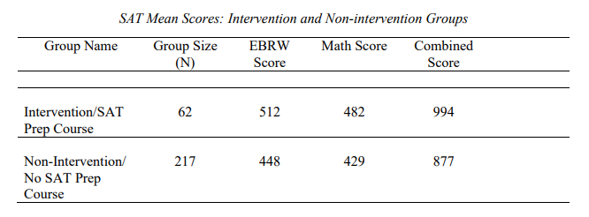
Study Results
The intervention group outperformed the non-intervention group by 117 points
The levels of improvement in math and writing were similar (64 points vs 53 points)

Slide 10
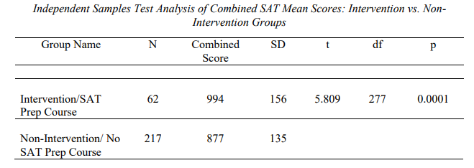
Analysis of Study Results
With a p value of .0001 the null hypothesis is rejected. The program was effective at raising scores
The intervention group was well within one standard deviation of reaching the 1010-point benchmark

Slide 11

Conclusion
SAT results in California vary widely by county
Surpassing the benchmark score of 1010 points is important for students
SAT scores are correlated with college acceptance rates
School-based SAT prep courses are effective

